Slide 1

#LifeKoKaroLift
Data Science Program
‹#›

Slide 2
Sampling
Random Sampling :
Simple Random Sampling
With replacement : When you do not have Good Number of Data points
Without replacement : When you have Good Number of Data points
Stratified Random Sampling (Stratification) (Homogeneous Distribution) : Stata’s/Smalll Sub-Categories/Sub-Divisions
EXAMPLE - PS : 1000 (45% A) (30%B) (25%C) SS: 100
Systematic Random Sampling : Pattern Oriented Random Sampling
Cluster Random Sampling :
Non-Random Sampling :
Opportunity
Convenience
Snowball

Slide 3


Module Name: EDA & Statistics
Course : Statistics
Lecture On : Statistics - Day - 10
Instructor :
‹#›

Slide 4
Today’s Agenda
Revision
Uses of Sampling in Market Research
Uses of Sampling in Market Campaigns
Uses of Sampling in Pilot Testing
Uses of Sampling in Quality Control
Key Takeaways
Data Science Certification Program
‹#›

Slide 5

Revision
In previous session, we learnt about:
Types of Sampling Methods
Standardised Normal Distribution and Z - Score
Sampling and Estimation

Slide 6
Uses of Sampling
There are four typical cases in which sampling is generally used:
Market research:
Suppose your company wants to launch a product whose usage depends on people having a decent internet connection, such as Hotstar or Netflix.
Before launching such a product, you need to understand the potential market size.
For this, you need to conduct a survey with a group of people, and based on their data, infer parameters such as the average data usage, the willingness to adopt new technologies, etc. for the entire population.

Slide 7
Uses of Sampling
2. Marketing campaign efficacy:
Suppose you work for a company such as Hotstar or Netflix. You want more and more people to move from your competitors’ platforms to your platform.
You plan to do this through a marketing campaign, but how should you structure this marketing campaign? What should be its budget? Which strategy should be used (free membership for a week, lower membership fees for a few weeks, etc.)?
You can use the data from your past marketing campaign and your knowledge of sampling techniques to make these decisions.

Slide 8
Uses of Sampling
3. Pilot testing:
Let’s take the Hotstar and Netflix example again. Suppose you have done all the market research required and developed a product.
Now, before putting your product out in the market, you want to give it a trial run. For this, you can perform what is called a pilot test.
It means that instead of giving your product a full-fledged launch, you can just launch it partially, i.e., to a few people who can test your product and help you decide whether it is good enough for a full launch.

Slide 9
Uses of Sampling
4. Quality control:
This is more of a manufacturing-centred application. Let’s say your company produces 10 million smartphones annually.
This means that around 30,000 phones are manufactured every day. In such a situation, quality assurance (QA) becomes a function of utmost importance.
Since it is difficult to check all 30,000 phones every day, your company would just ‘sample’ a few and then make decisions based on those samples.

Slide 10
Uses of Sampling in Market Research
You want to conduct a brand equity survey for e-commerce brands. In other words, you want to find out how much of the e-commerce market is controlled by Flipkart, Amazon and Snapdeal, respectively.
An important part of this process would be to conduct a survey, the results of which would tell you the proportion of Indian e-commerce buyers using each of these websites.
However, in order to do this, you would need to perform stratified sampling on the basis of gender, age and location (metro/tier 2/other urban/rural). By not doing this, you run the risk of erroneous selection, such as selecting too many people from metro areas or too few women, etc.
Hence, by not using stratified sampling, you might end up with an unrepresentative sample.

Slide 11
Uses of Sampling in Market Research
So, you give the questionnaire prepared by your team to the general public. Once you have acquired sufficient sample data, you can make estimations for the general population and estimate the brand equity of major Indian e-commerce brands.
However, you must not accept every entry you get. You can run some checks to filter fraudulent entries.
For example, if a person takes only 1 minute to fill a survey that usually takes 10 minutes, they are probably not filling it truthfully.
However, as much as you would like to believe that you have used stratified random sampling, there is a chance that the sampling done here is closer to stratified volunteer sampling or stratified opportunity sampling than to stratified random sampling.

Slide 12
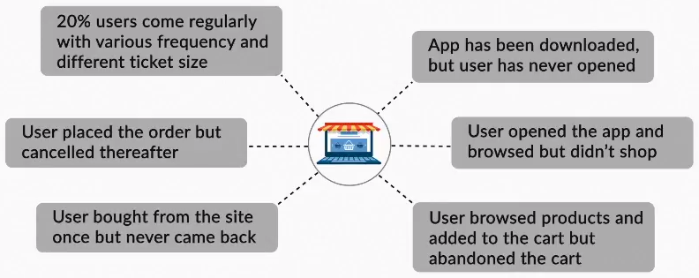
Uses of Sampling in Marketing Campaigns
Say you are running an e-commerce company that operates through an app/site. Broadly, there are six common types of problems that you could face, as illustrated below.

Slide 13
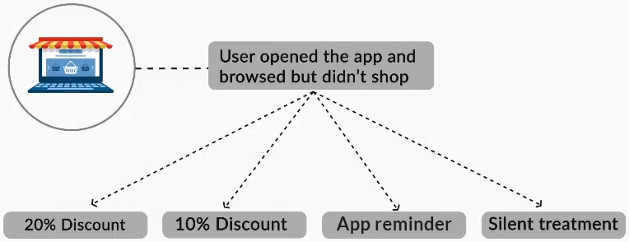
Uses of Sampling in Marketing Campaigns
Let’s pick one of the cases where the user opened the app and browsed but did not shop. How would you coax such a user to use the app again and actually shop? There are four different courses of action that you could take in order to get the user to use your app/site.

Slide 14
Uses of Sampling in Marketing Campaigns
Which one of these should you select? Is the strategy of giving a 20% discount more effective than the one in which you give only a 10% discount? Do you even need to give a discount? Is a reminder enough? Will the reminder even work, or will people just return to the app/site themselves after some time?
To answer all these questions, you would need to perform A/B testing.
Basically, you would divide your current customer base into four groups: group A, group B, group C and group D. Then, each of the groups would be subjected to one of the above strategies.
For example, group A would get a 20% discount coupon, group C would get an app reminder, etc. Then, when you get the data for these sample groups, you could use the concepts of hypothesis testing and sampling to answer the questions asked above.

Slide 15
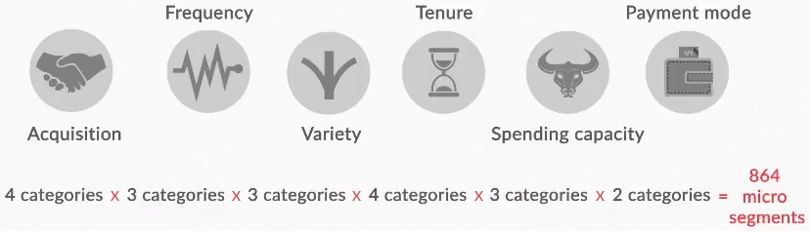
Uses of Sampling in Marketing Campaigns
Again, you could use stratified sampling here. But how would you do that? Well, first of all, you would need to break up your population into various small segments on the basis of factors such as the acquisition channel, the frequency of shopping, the payment mode generally used, etc.

Slide 16
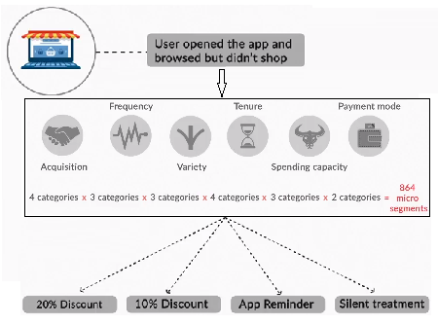
Uses of Sampling in Marketing Campaigns
Once you break your population into microsegments, you can get sample information for each segment. Remember that the reason for making these divisions is to ensure that the sample represents the population as closely as possible.
Finally, you would have your sample once you make these probably unbiased divisions, and once you get the sample, you can perform A/B testing.

Slide 17
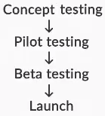
Uses of Sampling in Pilot Testing
If you are creating a product, you will follow the process given below.
Again, let’s say you are creating a mobile app for a web streaming service, such as Hotstar.
Before starting with the product development process, you will need to test your concept. This can be accomplished by asking a few people how they would feel about a web streaming service, and if such a service existed, how often would they use it? How much would they be willing to spend on it? For people who do not want to use it, what is the reason for not using it? Will they reconsider their decision if certain features are added to the product?

Slide 18
Uses of Sampling in Pilot Testing
Once you have the results of this concept test, you can start developing the actual product accordingly.
Now, when this product nears completion, you should have a few people try it out and collect their feedback.
Based on their feedback, you can make some last-minute changes that will help you rectify any mistakes or add small features that you may have missed.
This process of getting your product checked before its final development is called pilot testing.
Once this product, i.e., the streaming service, is developed in accordance with the results of the concept test and the pilot test, you can launch it.
However, if you wish to be really careful, there is one last thing you could do — you could have a few people try this developed product, take their feedback and make one more round of changes before you launch the product.
This process, where you get your final product checked, is called beta testing.

Slide 19
Uses of Sampling in Pilot Testing
There is scope for using sampling at various stages of the product development process:
In the initial stages, you want to talk to people and determine if they are interested in a digital payment service.
However, you need to be careful about how you design this survey; the people you talk to should include those already comfortable with cashless products such as credit cards and those who are only comfortable with cash.
While interpreting your findings, you need to make sure that each stratum of the society is represented correctly in the survey and that there are enough people of each type in your survey.
If you only interviewed 20 people who are comfortable with digital payments, you may need to use booster methods.

Slide 20
Uses of Sampling in Pilot Testing
In the final stages, during the pilot testing stage, you will need to use the sampling concepts again.
Since this stage also involves surveying people and making decisions for the population based on the sample you surveyed, you will need to stratify your sample accordingly, steer clear of biases, use boosters wherever needed, etc.

Slide 21
Uses of Sampling in Quality Control
Quality control is a process followed at manufacturing sites, where batches of the manufactured product are regularly checked to ensure that they meet the standards set by the company.
Since it will be very expensive and time-consuming to check each and every product manufactured, companies typically just check a few randomly selected products and take decisions for the entire batch based on those results.
Hence, you will need to apply the sampling theory here too. Think about it: you are deciding the quality of the entire batch on the basis of one or two samples.
Let’s understand how sampling is used in quality control.

Slide 22
Uses of Sampling in Quality Control
Let’s say you are inspecting a batch of bolts to assess their quality. You decide to check every 1,000th bolt and see whether it is manufactured as per the desired quality.
Since all the bolts you inspect turn out to be good, you decide that the batch has no defects.
However, there is a problem with this approach. What if the 6th product made by the machine is defective, and then, every 1000th product the machine makes after that is defective?
In that case, the defective pieces will have ID numbers as follows: 6, 1006, 2006, 3006 and so on.
However, since you are only checking every 1000th product, i.e., ID numbers 1000, 2000, 3000, etc., you will never find the defective pieces.

Slide 23
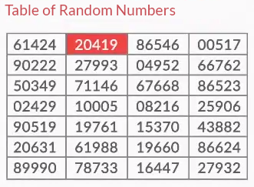
Uses of Sampling in Quality Control
The point is that if the defects occur in a pattern, then your best chances to catch them are if you randomly select batch numbers.
If your selection has any trend, you risk matching the pattern of the defects and missing out.
Hence, it is always advisable to use a table of random numbers to decide which batches you are going to inspect.

Slide 24
Key Takeaway
Revision
Uses of Sampling in Market Research
Uses of Sampling in Market Campaigns
Uses of Sampling in Pilot Testing
Uses of Sampling in Quality Control
Data Science Certification Program
‹#›

Slide 25
#LifeKoKaroLift
Thank You!
‹#›

